Slide 1
General Surgery Case-Based Learning for Clerks

Slide 2
Table of Contents
Appendicitis
Acute Cholecystitis
Diverticulitis

Slide 3
Case 1

Slide 4
Case 1: ED Consult
A 25-year-old woman with abdominal pain is in the emergency department. She describes a gradual onset of pain that started yesterday, which has been persistent in its location in the lower abdomen.
The senior resident asks you to see this patient in the emergency department. What would you ask on history?

Slide 5
History Template
“OPQRSTU”
Onset
Position
Quality (diffuse, colicky, sharp, well-localized)
Radiation
Severity
Timing
Deja-vU (previously experienced)
“AAA”
Alleviating
Aggravating
Associated (focused ROS: Systemic, GI, GU, Gyn, Resp, Cardio)
Risk Factors
Meds/allergies
Last meal
Past medical/surgical history
FHx
SHx
Substances (smoking, alcohol, drug use)
FIFE

Slide 6
Case 1: History
Her pain began 24 hours ago as “dull and in the middle” but has become a sharp, 6/10, lower abdominal pain. The pain does not radiate, and she has never experienced this before. She denies any N/V, diarrhea, constipation, or abnormal urinary symptoms. Her last menstrual period was approximately 12 days ago, and she denies any abnormal pattern in her menses. The patient is sexually active with one partner. Her past medical and surgical history is unremarkable. No relevant family history. She takes no medications and consumes alcohol socially.
What would you do on physical exam?

Slide 7
Physical Exam Template
Vitals
General inspection
Abdominal exam
Inspect
Auscultate
Percussion
Light + Deep Palpation
Special Tests
Peritonitis
Shake test
Rebound tenderness
Appendicitis
McBurney’s Point
Rovsing’s sign
Psoas sign
Obturator sign
DRE
Pelvic exam
Cardiorespiratory exam

Slide 8
Case 1: Physical Exam
Vitals: BP: 110/85, HR: 86, RR: 14, Temp: 38.3
Abdominal exam: soft, nondistended, tender to palpation in the suprapubic and right lower quadrant. No signs of peritonitis. No palpable mass. The bowel sounds are hypoactive. The rectal examination is unremarkable.
Pelvic exam: no purulent discharge; however there is tenderness in the right adnexal region.
Cardiorespiratory: unremarkable.
At this point, what is your differential diagnosis?

Slide 9
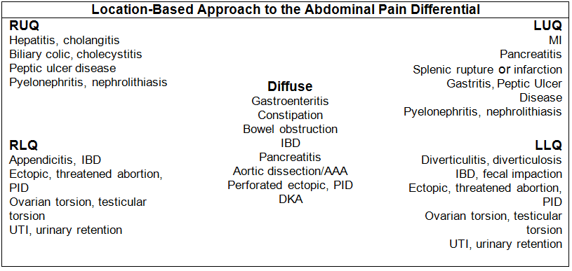
RLQ DDx
Source: TOsurg.ca

Slide 10
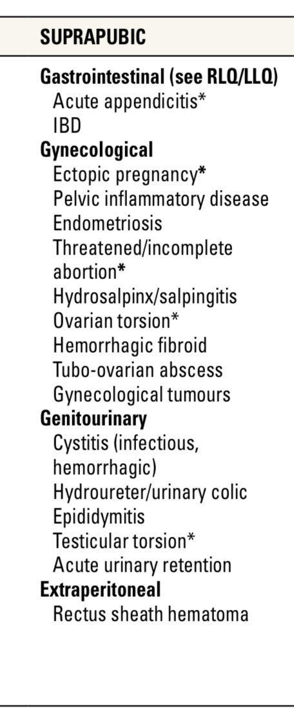
RLQ DDx Continued
Table 1. Differential Diagnosis of Acute Abdominal Pain from General Surgery and Thoracic Surgery Chapter, Toronto Notes 2020
Based on your DDx, what investigations would you order?

Slide 11
Investigations
Labs: CBC, urinalysis, beta hCG
Imaging
Ultrasound
CT if concern for complicated appendicitis or when ultrasound not feasible or inconclusive
Consider MRI in pregnancy

Slide 12
Case 1: Investigations
Lab results:
bHCG negative
Hemoglobin: 123 g/L
WBC Count: 12.0 X 10⁹/L
Platelets: 300 X 10⁹/L
Urinalysis: unremarkable
Ultrasound suggests appendicitis. What are imaging findings of appendicitis?

Slide 13
Ultrasound Findings: Appendicitis
Dilation (outer diameter of appendix) >6-7mm
Wall thickening (>3mm) and enhancement
hyperemia, echogenic periappendiceal fat, periappendiceal fluid
non-compressible appendix
Fecalith
Phlegmon (inflammatory mass)
Abscess
Given the diagnosis of appendicitis, what is your proposed treatment plan for this patient?

Slide 14
Case 1: Treatment
Resuscitation
Admit
NPO
IV Fluids
Antiemetics if continuous vomiting
Pain management
Antibiotics (cefazolin and metronidazole)
Surgery
Laparoscopic appendectomy
Medical Management Only?
Can be used for uncomplicated (non-perforated) appendicitis
Patients with fecalith can have 40% risk of perforation, thus antibiotics alone insufficient
Greater risk for older and immunocompromised patients
Risk of recurrence

Slide 15
Case 2

Slide 16
Case 2: ED Consult
A 48-year-old woman presents with a 1-day history of abdominal pain that began after dinner yesterday.
You are asked to see this patient in the emergency department. What would you ask on history?

Slide 17
Case 2: History
Your history reveals:
The pain initially began as a dull ache that felt a lot like the episodes of “indigestion” that she’s experienced several times over the past few months after meals. However, she says this episode has been the worst and has persisted much longer that usual. Her pain has now localized in the right upper abdomen. While in the emergency department, her symptoms have improved somewhat after receiving a dose of parenteral analgesia, but she reports that her pain is still a 6/10.
Associated with the pain, the patient had nausea but no vomiting.
Her history is significant for type 2 diabetes controlled with diet only. She does not smoke, drink alcohol, or use illicit substances. No relevant family or social history.
What would you do on physical exam?

Slide 18
Case 2: Physical Exam
Vital signs: BP 128/84, HR: 85, RR: 14, and temp: 37.9
Abdominal exam: non-distended, with some focal tenderness in the right upper quadrant
At this point, what is your differential diagnosis?

Slide 19
RUQ DDx
Source: TOsurg.ca

Slide 20
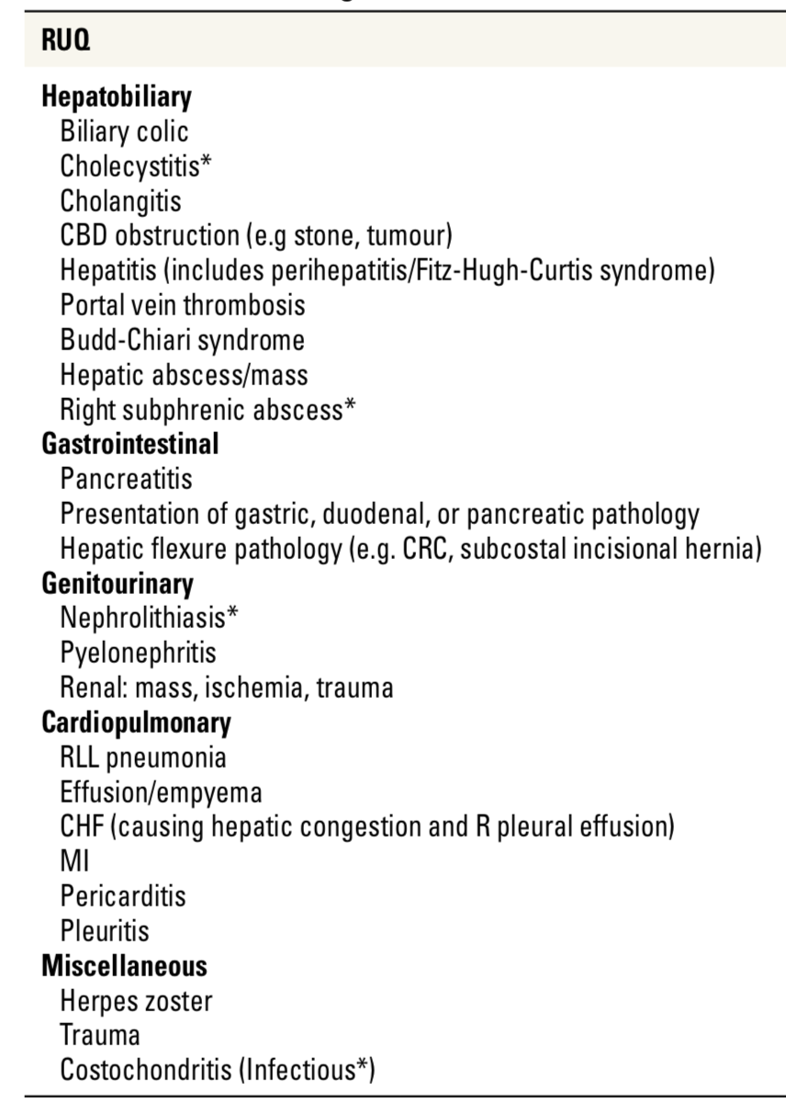
RUQ DDx Continued
Table 1. Differential Diagnosis of Acute Abdominal Pain from General Surgery and Thoracic Surgery Chapter, Toronto Notes 2020
Based on your DDx, what investigations would you order?

Slide 21
Investigations
Labs: CBC, electrolytes, glucose, LFTs, fractionated bilirubin, urinalysis, amylase
Imaging: ultrasound

Slide 22
Case 2: Investigations
Her WBC count is 13 x 10⁹/L and the remainder of her laboratory studies including chemistries, serum glucose, liver function tests, urinalysis, and amylase are within normal limits.
Her ultrasound suggests acute cholecystitis. What are imaging findings of acute cholecystitis?

Slide 23
Ultrasound Findings: Acute Cholecystitis
Calculi in the gallbladder
Anterior gallbladder wall thickening > 3 mm
Pericholecystic fluid
Gallbladder distension
Hypervascularization of the gallbladder wall on Doppler
Positive sonographic Murphy’s sign
Given the diagnosis of acute cholecystitis, what is your proposed treatment plan for this patient?

Slide 24
Case 2: Treatment
Admit to General Surgery
NPO
IV Fluids
Analgesia
Antibiotics (cefazolin/ancef)
Surgery
laparoscopic cholecystectomy
Early preferred (<72h)*
Emergent OR if high risk (emphysematous or gangrenous)
If patient unstable → cholecystostomy

Slide 25
Quick Recap of Biliary Tract Diseases
Disease | Pathogenesis | Presentation
Biliary Colic | Gallstone transiently impacted in cystic duct (no infection) | Pain RUQ <6 hours, crescendo-decrescendo, postprandial (fatty meal)
Acute Cholecystitis | Inflammation of gallbladder resulting from sustained gallstone impaction cystic duct | Pain RUQ >6 hours, N/V, low grade fever, Murphy’s sign, Boas’ sign, hx of biliary colic
Acalculous Cholecystitis | Acute or chronic cholecystitis in the absence of stones, typically due to gallbladder ischemia and stasis | Seen in ICU patients, trauma patients, DM, immunosuppression, TPN, and sepsis 10% of acute cholecystitis cases
Choledocholithiasis | Stones in CBD | 50% asymptomatic, Pain RUQ or epigastrium, jaundice, dark urine, pale/alcoholic stool, hx biliary colic
Acute Cholangitis | Obstruction of CBD leading to biliary stasis, bacterial overgrowth, suppuration, and biliary sepsis. Obstruction causes: choledocholithiasis (60%), stricture, neoplasm (pancreatic or biliary), extrinsic compression (pancreatic pseudocyst or pancreatitis), instrumentation of bile ducts (PTC, ERCP), biliary stent | Charcot’s triad: fever ,RUQ pain, and jaundice Reynold’s pentad: fever, RUQ pain, jaundice, shock, and confusion +/-N/V, abdominal distention, ileus, pale/acholic stools, dark urine
Gallstone Ileus | Fistula: from repeated inflammation, causes a cholecystoenteric fistula (usually duodenal) Gallstone through fistula: large gallstone enters the GI tract Gallstone impaction: impacts near the ileocecal valve, causes a mechanical bowel obstruction | Bowel obstruction symptoms

Slide 26
Case 3

Slide 27
Case 3: ED Consult
You’re on call for general surgery and you’re paged to the emergency department. You find the patient’s chart and see that the patient is a 61-year-old man who’s complaining of lower abdominal pain and nausea.
What would you ask on history?

Slide 28
Case 3: History
The patient tells you that he has been experiencing left lower abdominal pain for 1 week. He says the pain has been increasing (now 8/10) and he has also been experiencing nausea and vomiting. He explained that he came in for medication because he’s had a similar, milder episode in the past that resolved with antibiotics.
Past medical history is significant for hypercholesterolemia, obesity, diabetes mellitus type 2, and benign prostatic hyperplasia.
The patient doesn’t drink alcohol or smoke. No relevant social or family history.
What would you do on physical exam?

Slide 29
Case 3: Physical Exam
Vitals: BP: 130/86, RR: 16, HR: 110, temp: 38.3
Abdominal exam: mildly distended, with localized tenderness and guarding to palpation in the left lower quadrant. No findings on DRE.
Urological exam: no flank tenderness, no findings on exam of genitalia.
At this point, what is your differential diagnosis?

Slide 30
LLQ DDx
Source: TOsurg.ca

Slide 31
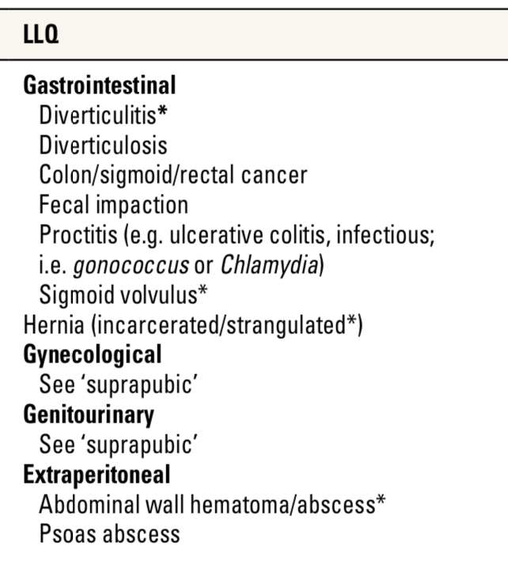
LLQ DDx Continued
Table 1. Differential Diagnosis of Acute Abdominal Pain from General Surgery and Thoracic Surgery Chapter, Toronto Notes 2020
Based on your DDx, what investigations would you order?

Slide 32
Investigations
Labs:
CBC
electrolytes (vomiting)
Cr
Lactate (peritonitis – perforation?)
Blood cultures (likely infection given tachycardia and fever)
Urinalysis (possible UTI or other urological condition)
Imaging:
upright CXR for free air (perforation?)
CT

Slide 33
Case 3: Investigations
Labs: elevated WBC (17 x 10⁹/L), otherwise unremarkable
Imaging:
Upright CXR: no free air
CT: suggests diverticulitis with localized abscess (3cm) at a pericolonic site.
What are the imaging findings of diverticulitis?

Slide 34
CT Findings: Diverticulitis
presence of diverticuli
fat stranding
colonic wall thickening
Abscess
Fistula
extraluminal air
Intramural air

Slide 35
Staging: Diverticulitis
Tochigi T, Kosugi C, Shuto K, Mori M, Hirano A, Koda K. Management of complicated diverticulitis of the colon. Ann Gastroenterol Surg. 2017;2(1):22-27. Published 2017 Sep 28. doi:10.1002/ags3.12035
Which Hinchey classification applies to our patient?

Slide 36
Treatment: Diverticulitis
Tochigi T, Kosugi C, Shuto K, Mori M, Hirano A, Koda K. Management of complicated diverticulitis of the colon. Ann Gastroenterol Surg. 2017;2(1):22-27. Published 2017 Sep 28. doi:10.1002/ags3.12035

Slide 37
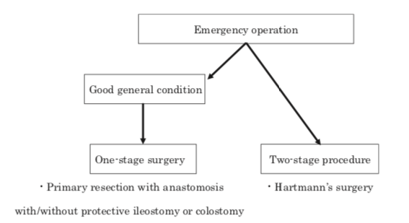
Case 3: Treatment
Admit to General Surgery
NPO
IV Fluids
Analgesia
IV Antibiotics: cefazolin + metronidazole
Abscess: percutaneous ultrasonography- or CT-guided abscess drainage
If drainage fails or the patient becomes severe and diffusely peritonitic (Hinchey III-IV)→ emergency operation
Hartman’s procedure
Primary resection with anastomosis, with or without protective ileostomy or colostomy
*Other possible option: laparoscopic lavage, similar mortality however higher rate of reoperation
Follow up: colonoscopy in 4-6 weeks to r/o malignancy
Tochigi T, Kosugi C, Shuto K, Mori M, Hirano A, Koda K. Management of complicated diverticulitis of the colon. Ann Gastroenterol Surg. 2017;2(1):22-27. Published 2017 Sep 28. doi:10.1002/ags3.12035

